Slide 1
MOS INVERTERS

Slide 2
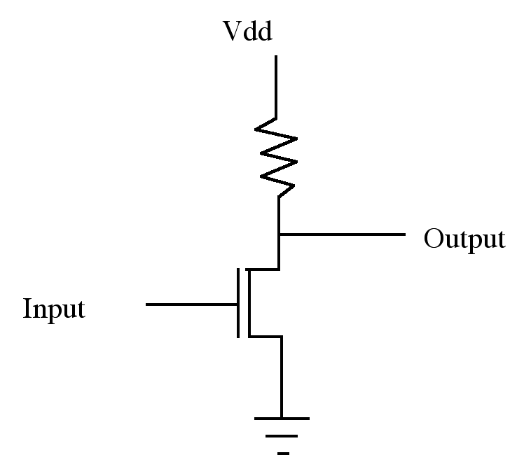
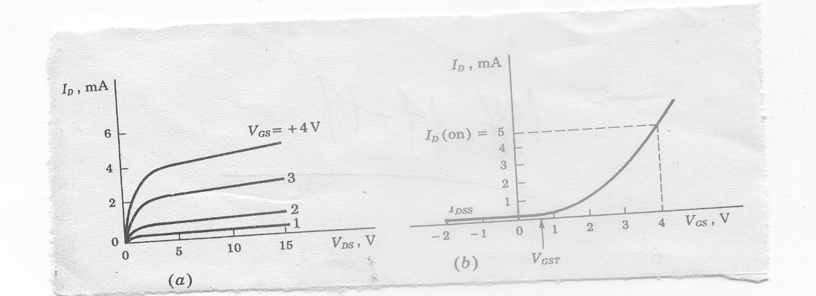
NMOS Inverter
Enhancement NMOS: (a) I_{D} versus V_{DS} (b) I_{D} versus V_{GS}
Inverter Operation
- Plus signal input turns transistor on
- Ground is connected to output, thus a 1 (+) in gives 0 (Gnd) out
- A 0 input opens transistor and output is pulled high by resistor

Slide 3
NMOS Inverter
Resistor dissipates heat
Fabrication of resistor is not easy
Even modest values of Resistors occupy excessively large areas in silicon substrate

Slide 4
A transistor may be used as a resistor
V_{DD}
Pull up
Output
Input
Pull down
In Pull down NMOS
For input=1, Pull down conducts
For input =0, Pull down is off

Slide 5
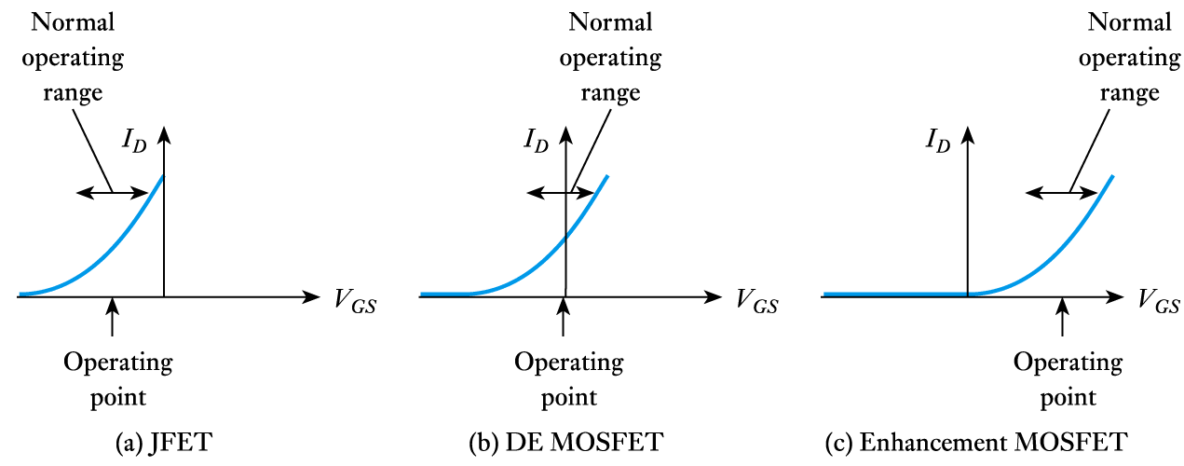
V_{DD}
Pull up as an enhancement type NMOS
Pull up transistor input (V_{GG}) should be high
V_{GG}
Pull up
Output
Input
Pull down

Slide 6
Pull up as an enhancement NMOS
V_{out}
V_{DD}
V_{DD}
V_{tpu}
V_{GG}
Pull up
Output
Input
Pull down
Non zero output
V_{tpd}
V_{in}
Dissipation is high since current flows when input=1
V_{out} can never be zero
V_{out} can never reach VDD (logical 1) if V_{GG}=V_{DD} as is normally the case
If V_{GG} is higher than V_{DD}, then an extra rail is required

Slide 7
Depletion type NMOS is used in pull up for better performance
V_{DD}
Gate and Source is shorted to achieve V_{GS}=0
In Pull down NMOS
For input=1, Pull down is on
For input =0, Pull down is off
Pull up is always on
Output
Input

Slide 8
Depletion type NMOS is used in pull up for better performance
V_{DD}
V_{out}
V_{DD}
No current
Output
Current flows
Input
Non zero output
V_{tpd}
V_{in}
Dissipation is high since current flows when input=1
V_{out} can never be zero

Slide 9
Drawbacks of Metal-gate MOS Transistors
High current flow for input at logic 1 in case of an inverter
Excess surface state charges and mobile ion contamination cause the threshold variation.
V_{out} never becomes exactly zero
Suffer from excessive overlap capacitance.
Parasitic capacitances C_{gs} and C_{gd} slow the transistor because they must be charged and discharged during switching.
Aluminum is used as gate material which can erode completely causing contact spiking.

Slide 10
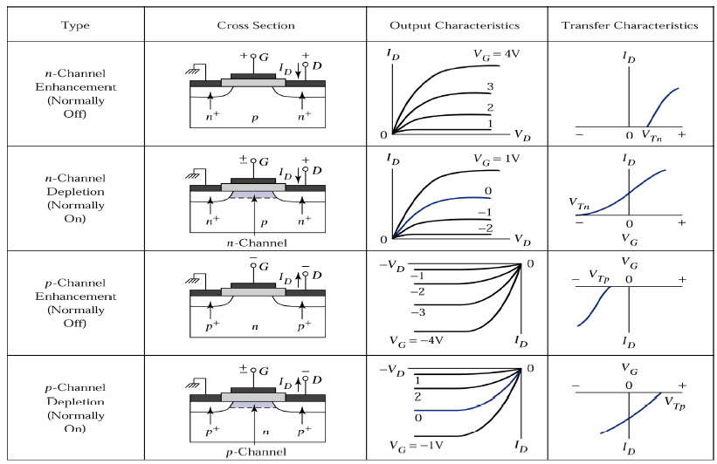
Types of MOSFET
Pullup may be enhancement type PMOS

Slide 11
Complementary MOS Transistors (CMOS)
V_{DD}
p
When A is pulled high (V_{DD}), the PMOS inverter is turned off, while the NMOS is turned on pulling the output down to V_{SS}
When A is pulled low (V_{SS}), the NMOS inverter is turned off, while the PMOS is turned on pulling the output up to V_{DD}
A
Y = A'
n
GND

Slide 12
Complementary MOS Transistors (CMOS)
V_{out}
V_{DD}
V_{DD}
p
p on
n off
n on
p off
A
Y = A'
Both on
n
GND
V_{tpd}
V_{in}
No current flow either for logical 0 or for logical 1 inputs
Full logical 1 and 0 levels are presented at output
For devices of similar dimension p-channel is slower than n-channel device

Slide 13
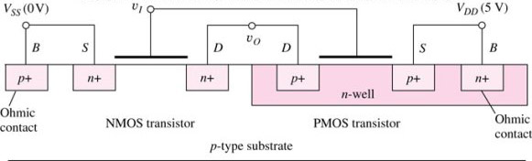
Complementary MOS Transistors (CMOS)
V_{DD}
S
G
p
D
A
Y = A'
D
n
G
S
GND

Slide 14
CMOS Inverter Technology
Complementary MOS, or CMOS, needs both PMOS and NMOS devices for their logic gates to be realized
The concept of CMOS was introduced in 1963 by Wanlass and Sah, but it did not become common until the 1980’s as NMOS microprocessors were dissipating as much as 50 W and alternative design technique was needed
CMOS still dominates digital IC design today

Slide 15
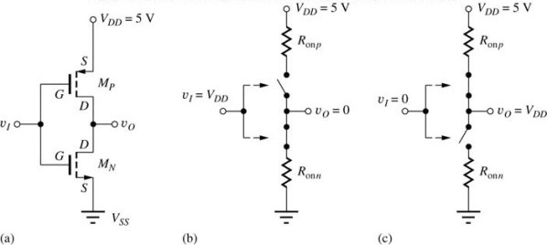
CMOS Inverter
Circuit schematic for a CMOS inverter
Simplified operation model with a high input applied
Simplified operation model with a low input applied

Slide 16
Bipolar Technology | CMOS
Higher switching speed | Lower switching speed
It offers high power dissipation. | less power dissipation
low packing density. | high packing density
unidirectional device | Bi-directional capability (drain & source are interchangeable)
better noise performance | Weak noise performance
lower input impedance (high drive current) | High input impedance and low drive current.
It offers lower delay sensitivity to load. | It offers higher delay sensitivity to load (i.e. it has fan out limitation.)
It has higher trans-conductance, | It has lower trans-conductance,
higher manufacturing cost per device | low manufacturing cost per device.

